Slide 1
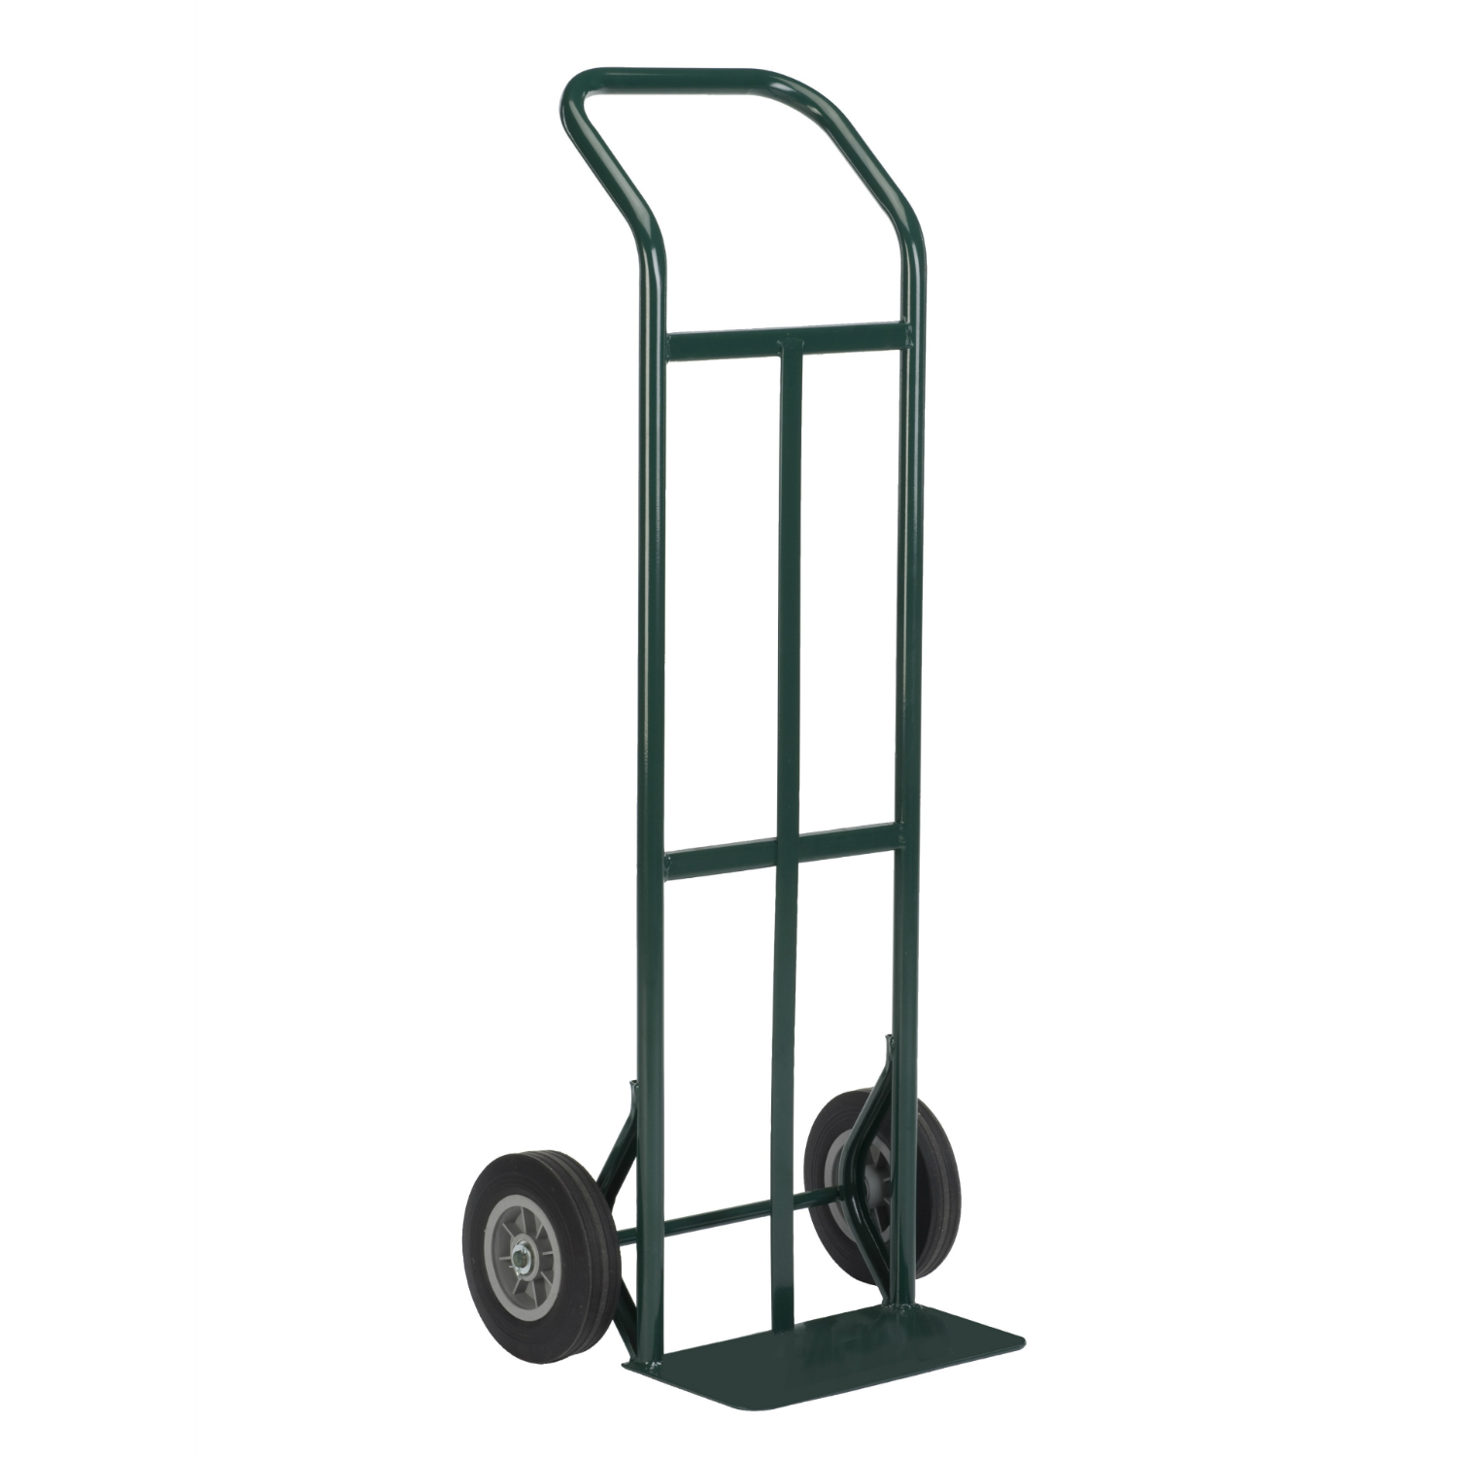
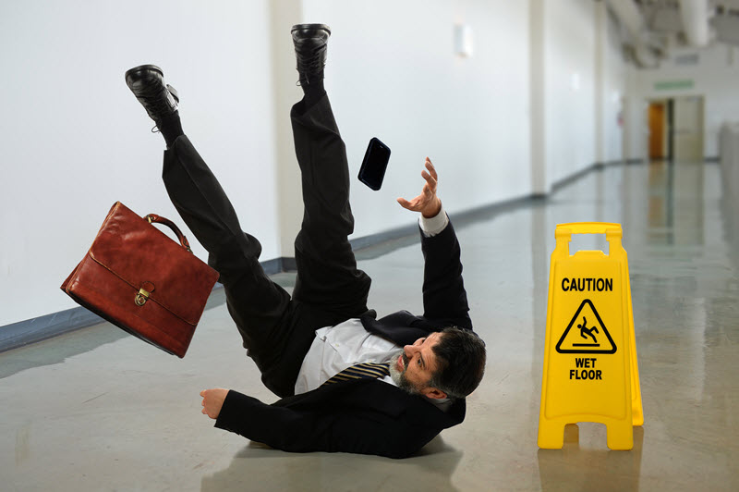
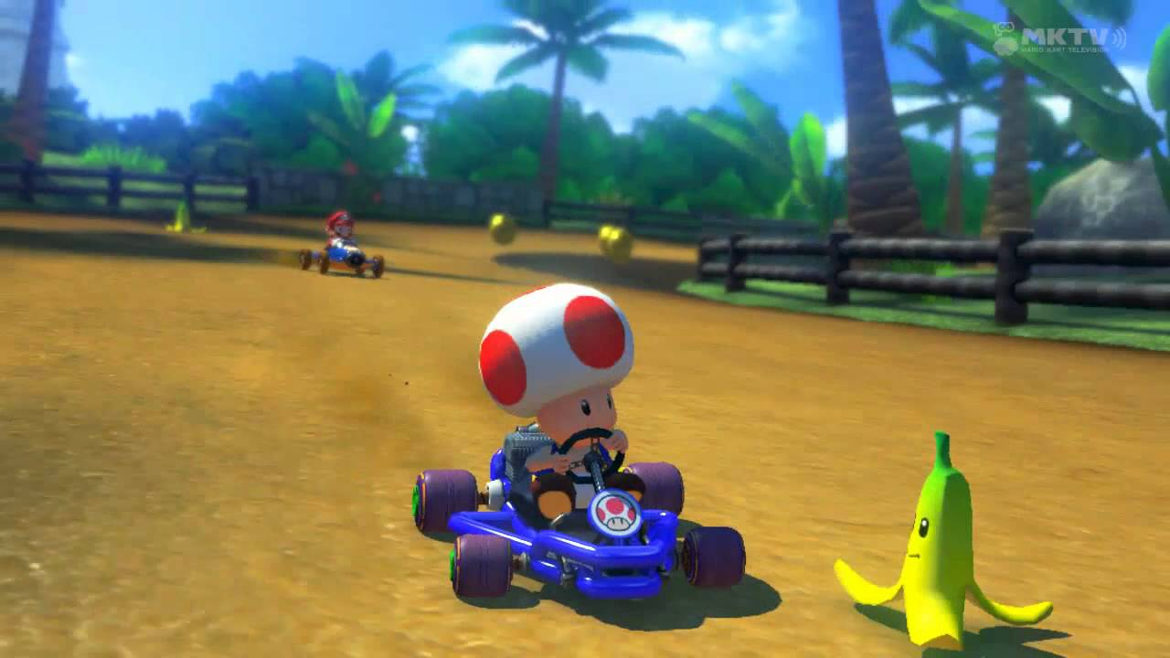
Brainstorm Questions
1) What things can make something move?
2) What features or factors make something hard to move?
3) What “inventions” have been made to make things move easier?

Slide 2
Chapter 11: Motion
Displacement, Velocity, & Acceleration

Slide 3
Graphs: What they tell us

Slide 4
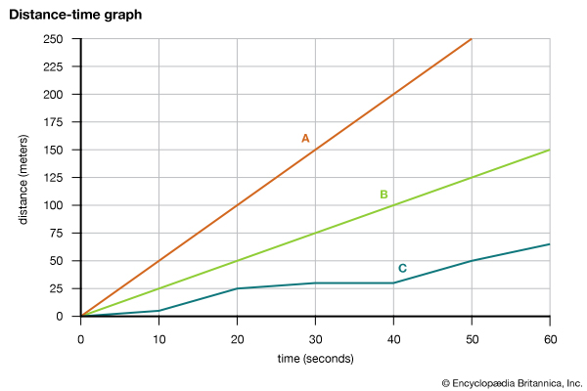

Slide 5
Reference Point
Reference Point: A place or object used for comparison to determine if something is in motion.
Examples:
Are you moving in your desk right now?
Think of a sensor, a phone taking a video.

Slide 6
Frame of reference Example
Are these people moving?

Slide 7
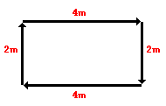
Distance vs. Displacement
Distance – how much ground an object has covered during its motion
Displacement – How far out of place an object is, change of position
Ex: Mr. Wieme walks 4 meters East, 2 meters South, 4 meters West and finally 2 meters North.

Slide 8
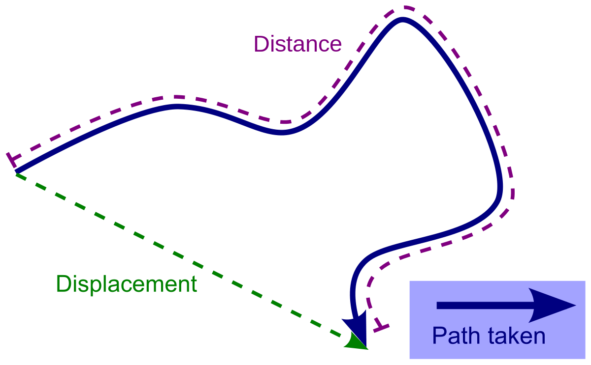

Slide 9
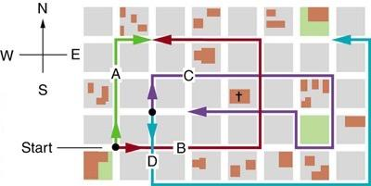

Slide 10
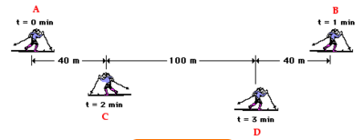
Example 2
What is the skier’s distance and displacement during the three minutes as the skier moves from A to B to C to D?

Slide 11
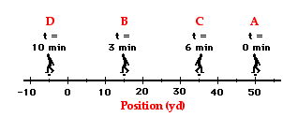
Example 3
What is the coach’s resulting displacement and distance of travel as he paces back and forth along the sidelines?

Slide 12
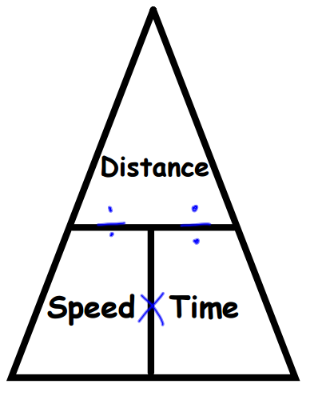
Speed
Speed=How fast an object is moving.
Average Speed =
Distance / Time
Units?

Slide 14
Put on back of your practice quiz, just show your math.
If a rocket is traveling 320m/s, how many meters will it travel in 10 seconds?
If a golf cart travels 100 miles in 20 hours, how fast is it going?
If a car was traveling 23m/s and it went a total distance of 230m, how many seconds was it moving?

Slide 15
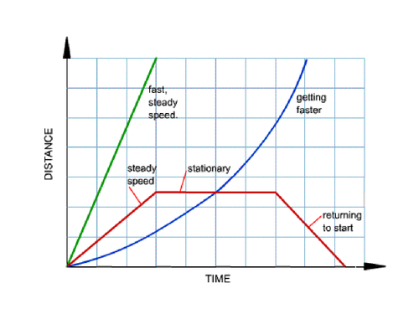
Distance-Time Graph

Slide 16
Velocity
The rate at which an object changes its position.
Keeps track of the speed AND the direction of travel.
Ex: The hurricane is moving at a speed of 10 km/h East
Average Velocity = change in position/time or
displacement/time

Slide 17
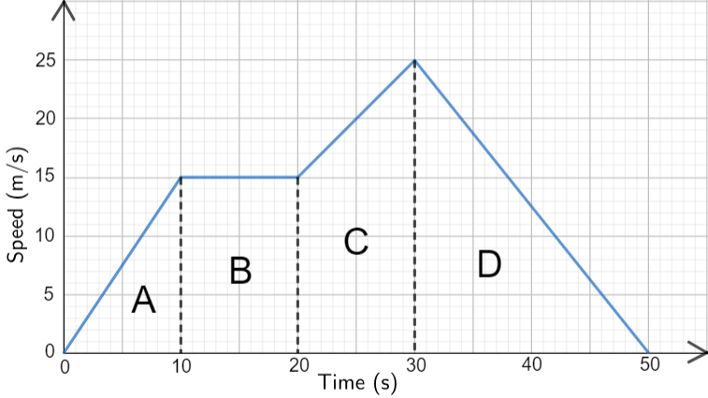
Velocity-Time Graph

Slide 18
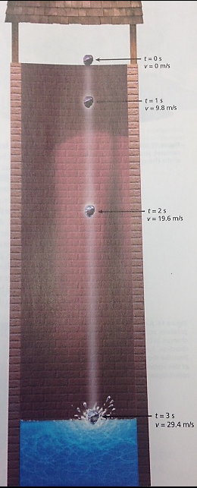
Acceleration
Rate at which velocity changes
Increasing speed = positive acceleration
Ex: A car moving from a stopped position
Decreasing Speed = Negative acceleration or deceleration
Ex: A jet landing on a runway

Slide 20
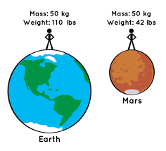

Slide 21
Units = m/s²

Slide 22
Working with examples of motion
A student walks 10 blocks to a computer store, how long will it take him to reach the computer store if he walks 3 blocks in 2 minutes?

Slide 23
Working with examples of motion
A student practicing for a track meet ran 250 m in 30 sec.
What was her average speed?
If on the following day she ran 300 m in 30 sec, by how much did her speed increase?

Slide 24
Working with examples of motion
How fast was the plane flying if it traveled 400 km in 30 minutes?

Slide 25
Working with examples of motion
If the average speed of a car is 45 km/hr, how far can it travel in 40 minutes?

Slide 26
Example 1
What is the average speed and average velocity of the skier?

Slide 27
Example 2
What is the coaches average speed and average velocity?

Slide 28
Acceleration
Rate at which velocity changes
Increasing speed = positive acceleration
Ex: A car moving from a stopped position
Decreasing Speed = Negative acceleration or deceleration
Ex: A jet landing on a runway

Slide 29
Units = m/s²

Slide 30
Acceleration Example 1
A driver starts his parked car and within 5 seconds reaches a velocity of 54 km/hr as he travels east. What is his acceleration?

Slide 31
Acceleration Example 2
Fallling objects drop with an average acceleration of 9.8 m/sec². If an object falls from a tall building, how long will it take before it reaches a speed of 49 m/sec?

